Slide 1
Outlier Detection & Analysis
By: Sudhanshu Shekhar
Adm no: 16JE001971
Branch : Computer Science

Slide 2
Content
Introduction / Motivation / Definition
Statistical-based Detection
Depth- based Detection
Deviation-based Method
Distance-based Detection
Greedy Algorithm (fastest approach)
Summary

Slide 3
Motivation for Outlier Analysis
Fraud Detection (Credit card, telecommunications, criminal activity in e-Commerce)
Customized Marketing (high/low income buying habits)
Medical Treatments (unusual responses to various drugs)
Analysis of performance statistics (professional athletes)
Weather Prediction
Financial Applications (loan approval, stock tracking)
“One persons noise could be another person’s signal.”

Slide 4
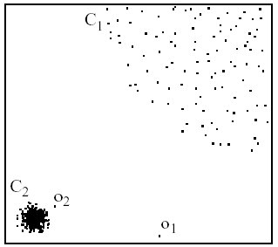
What is an outlier?
Observations inconsistent with rest of the dataset – Global Outlier
Special outliers – Local Outlier
  Observations inconsistent with their neighborhoods
  A local instability or discontinuity

Slide 5
Causes of Outliers
Poor data quality / contamination
Low quality measurements, malfunctioning equipment, manual error
Correct but exceptional data

Slide 6
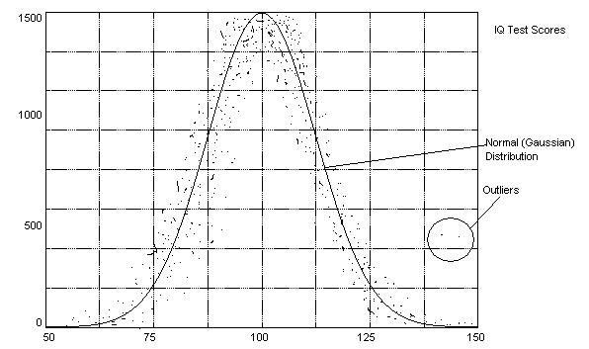
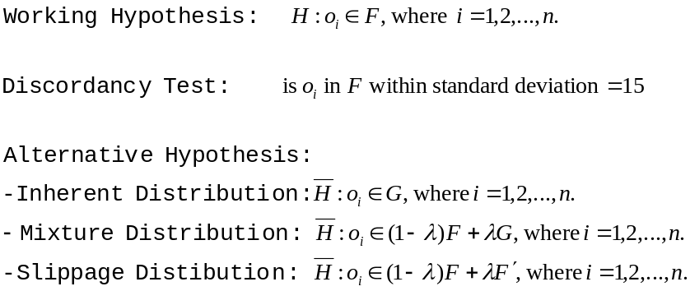
Statistical-Based Outlier Detection (Distribution-based)
Assumptions:
  Knowledge of data (distribution, mean, variance)
Statistical discordancy test
  Data is assumed to be part of a working hypothesis (working hypothesis)
  Each data object in the dataset is compared to the working hypothesis and is either accepted in the working hypothesis or rejected as discordant into an alternative hypothesis (outliers)

Slide 7
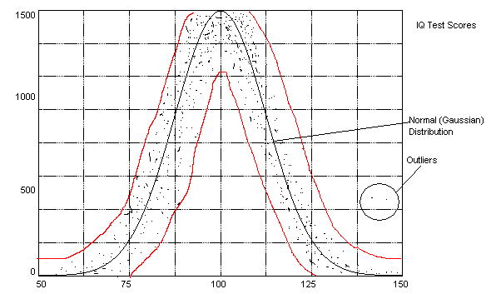
Statistical-Based Outlier Detection (Distribution-based)
Assumptions:
  Knowledge of data (distribution, mean, variance)
Statistical discordancy test
  Data is assumed to be part of a working hypothesis (working hypothesis)
  Each data object in the dataset is compared to the working hypothesis and is either accepted in the working hypothesis or rejected as discordant into an alternative hypothesis (outliers)

Slide 8
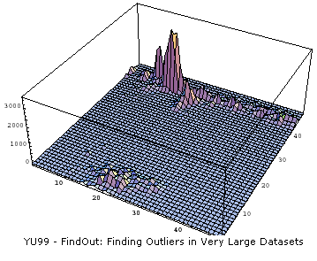
Statistical-Based Outlier detection (Depth-based)
Data is organized into layers according to some definition of depth
Shallow layers are more
likely to contain
outliers than deep
layers
Can efficiently handle
computation for k < 4

Slide 9
Statistical-Based Outlier Detection
Strengths
  Most outlier research has been done in this area, many data distributions are known
Weakness
  Almost all of the statistical models are univariate (only handle one attribute) and those that are multivariate only efficiently handle k<4
  All models assume the distribution is known –this is not always the case
  Outlier detection is completely subjective to the distribution used

Slide 10
Deviation-Based Outlier Detection
Simulate a mechanism familiar to human being: after seeing a series of similar data, an element disturbing the series is considered an exception
Sequential Exception Techniques
OLAP Data Cube Techniques

Slide 11


Sequential Exception
Select subsets of data Ij (j=1,2,…,n) from the dataset I
Compare the dissimilarity of I and (I-Ij)
Find out the minimum subset Ij that reduce the disimuliarity the most
Smoothing factor
  D is a dissimilarity function
  C is a cardinality function, for example, the number of elements in the dataset

Slide 12
Example
Let the data set I be the set of integer values {1,4,4,4}
I_{j} | I- I_{j} | C(I- I_{j}) | D(I- I_{j}) | SF(I_{j})
{} | {1,4,4,4} | 4 | 1.69 | 0.00
{4} | {1,4,4} | 3 | 2.00 | -0.93
{4,4} | {1,4} | 2 | 2.25 | -1.12
{4,4,4} | {1} | 1 | 0.00 | 1.69
{1} | {4,4,4} | 3 | 0.00 | 5.07
{1,4} | {4,4} | 2 | 0.00 | 3.38
{1,4,4} | {4} | 1 | 0.00 | 1.69
Note, when I_{j} = {}, D(I) = D(I-I_{j}) = 1.69, SF(I_{j})=0
When I_{j}={1}, SF(Ij) has the maximum value, so {1} is the outlier set

Slide 13
OLAP Data Cube Technique
Deviation detection process is overlapped with cube computation
Precomputed measures indicating data exceptions are needed
A cell value is considered an exception if it is significantly different from the expected value, based on a statistical model
Use visual cues such as background color to reflect the degree of exception

Slide 14
Outlier Analysis - Outline
Introduction / Motivation / Definition
Statistical-based Detection
  Distribution-based, depth-based
Deviation-based Method
  Sequential exception, OLAP data cube
Distance-based Detection
  Index-based, nested-loop, cell-based, local-outliers
Questions

Slide 15
Distance-Based Outlier Detection
Distance-based: An object O in a dataset T is a DB(p,D) outier if at least fraction p of the objects in T are >= distance D from O
A point O in a dataset is an outlier with respect to parameters k and d if no more than k points in the dataset are at a distance of d or less from O.
Relative measurement: Let D^{k}(O) denote the distance of the k^{th} nearest neighbor of O. It is a measure of how much of an outlier point O is.

Slide 16
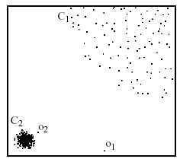
Distance-Based Outlier Detection (Local Outliers)
Some outliers can be defined as global outliers, some can be defined as local outliers to a given cluster
O₂ would not normally be considered an outlier with regular distance-based outlier detection, since it looks at the global picture

Slide 17
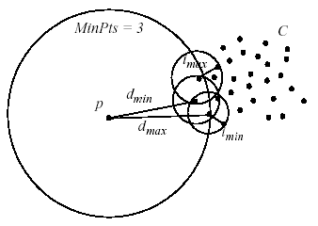
Distance-Based Outlier Detection (Local Outliers)
Each data object is assigned a local outlier factor (LOF)
Objects which are closer to dense clusters receive a higher LOF
LOF varies according to the parameter MinPts

Slide 18
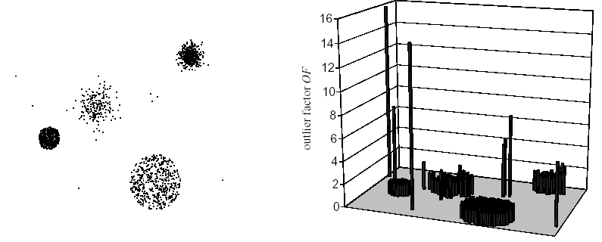
Distance-Based Outlier Detection (Local Outliers)

Slide 19
Distance-Based Outlier Detection (Partition-based)
Partition-based detection
  Use BIRCH clustering to identify clusters/partitions of non-outliers
  Prune partitions that do not contain outliers
  Use Index/Nested Loop algorithms on the remaining data points
  Since many data point are removed during pruning, the efficiency is increased significantly.

Slide 20
OUR METHOD USING
GREEDY ALGORIITHM
Input taken is the number of outliers(k).
Initially all data in data set are Non outliers.
K scans are performed.
In each scan an outlier is detected ie the element that shows major Entropy change after removal is called an outlier in that scan.
Loop breaks after k scans, each scan giving an Outlier.

Slide 21
Data Structure Used
Given a dataset D with n multidimensional vectors then we need n Hash tables for representation of the the dataset . Thus in O(1) time we can find the frequency of attribute.

Slide 22
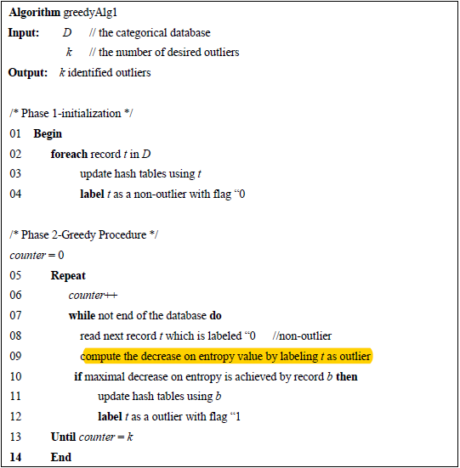
ALGORITHM USED

Slide 23
TIME COMPLEXITY
The time complexity of our algorithm is O(n*m*k*p) , where n is the size of data set , k is the number of outliers , m is the number of attributes and p is the number of distinct attribute values.
As using hash reduces the impact of p thus the net complexity is O(n*m*k).
This is far less than than LSA algorithm . O(n*m*k*l) . L>10.

Slide 24
SPACE COMPLEXITY
AS the algorithm only need to store m hash table and n data sets thus the space complexity is O(p+n)(m)

Slide 25
SUMMARY
Convectional outlier mining algorithms do not handle categorical data in a satisfactory manner. To fulfil this void, the very fast greedy algorithm for mining is provided.
Experimental results show the high ability of this algorithm.

